Slide 1
MASS SPECTROMETRY lect. 2 Dr: leaqaa Abd Al-Redha

Slide 2
Fragmentation pathways: - structural information is available from analysis of fragments formed by bond cleavages in molecular ion, M⁺ . - in general, M⁺ will fragment so as to form the most stable cationic fragment (carbocation) - in some cases, M⁺ peak is very small or absent. (fragments more stable )

Slide 3
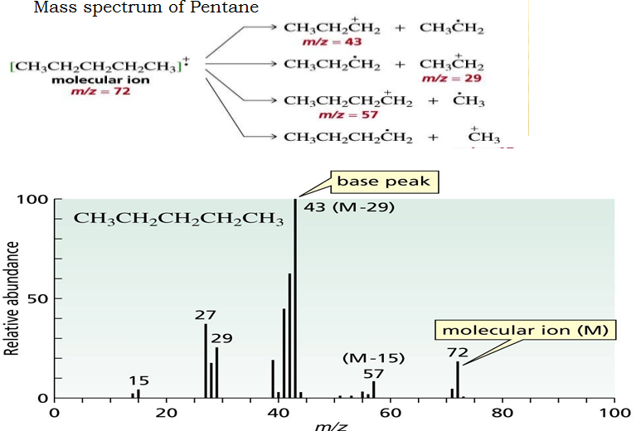

Slide 4
* most common mode of fragmentation involves the cleavage one bond, in this process , the odd-electron M⁺ yields an odd-electron neutral fragment and an even-electron fragment ion. The neutral fragment that is lost is a radical, and the ionic fragment is of the carbocation type. Cleavages which lead to formation of more stable carbocation are favored. thus,ease of fragmentation to form ions increases in the order.

Slide 5
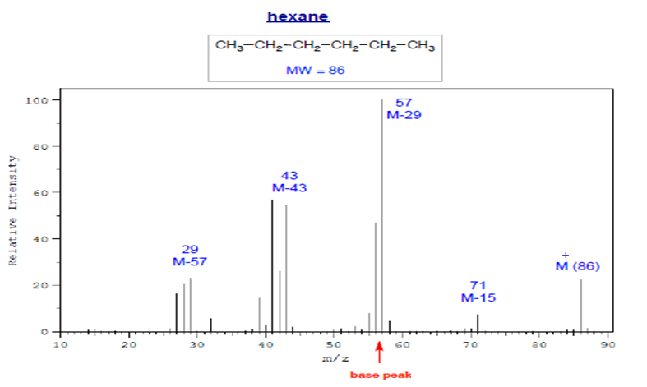
Straight Chain Alkanes [R-Rˉ ]→ R⁺ + ͘͘Rˉ [M⁺]= weak * preference small R⁺ C3H7⁺, C4H8⁺ ,C5H11⁺ • A peak for M-CH3 is often weak or absent

Slide 6
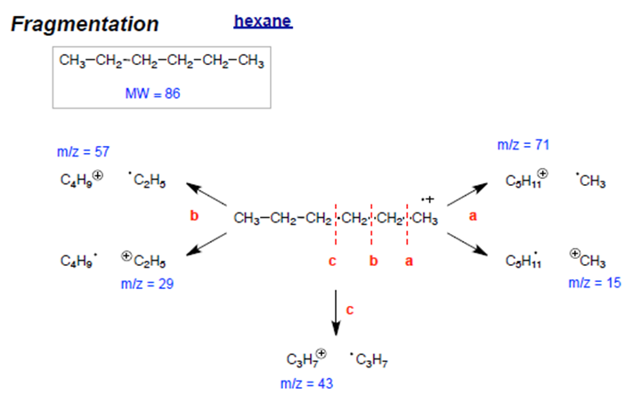

Slide 7
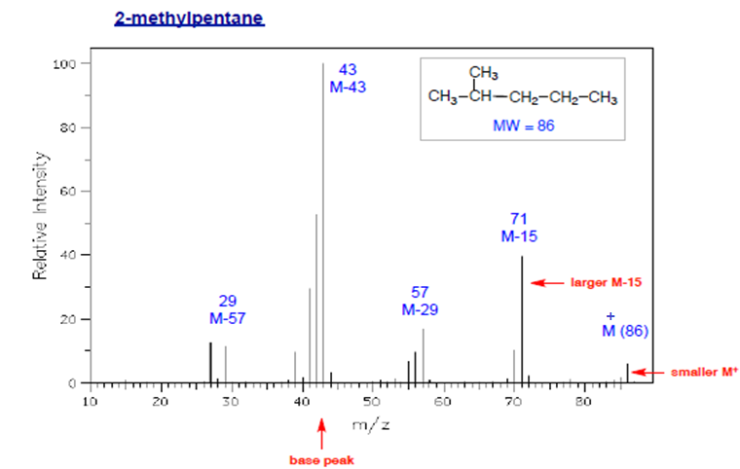
Branched Alkanes • Smaller M⁺ peak; may be absent • More fragmentation at highly branched positions * preference for 2 ͦ, 3 ͦcarbocation

Slide 8
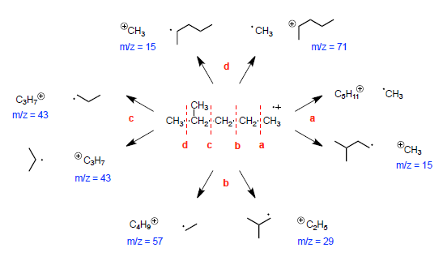

Slide 9
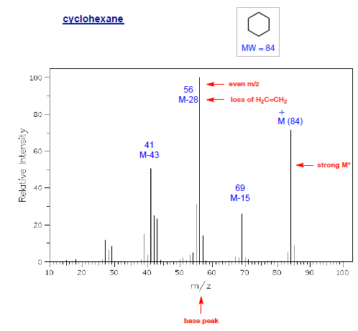
Cycloalkanes • Relatively large M⁺ peak • Significant peak at M-28 (often the base peak) due to loss of ethylene • M-15: from rearrangement

Slide 10
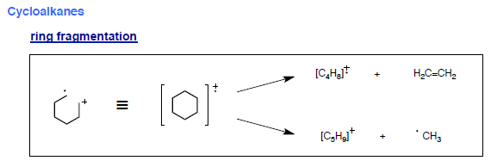
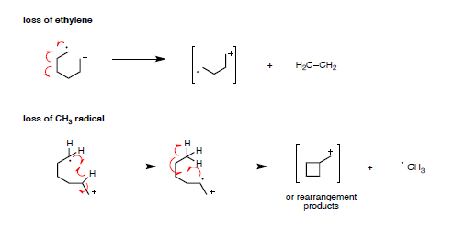

Slide 11
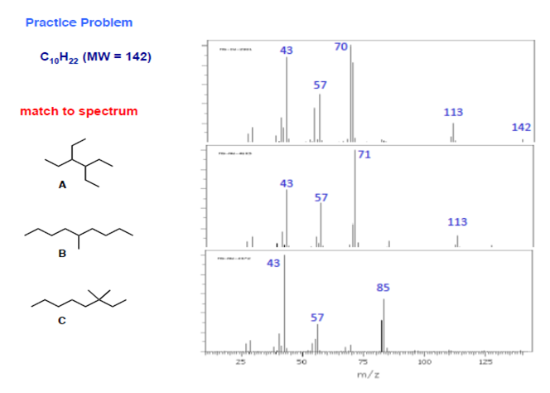

Slide 12
Alkenes Acyclic Alkenes • Relatively strong M⁺ ion • A series of peaks: M-15, M-29,M-43,M-57, etc • Strong peak from fragmentation to form a resonance stabilized allylic cation(m/z = 41 in terminal double bond. * homolytic cleavage to give allylic carbocation

Slide 13
* Allylic carbocation: m/e=41

Slide 14
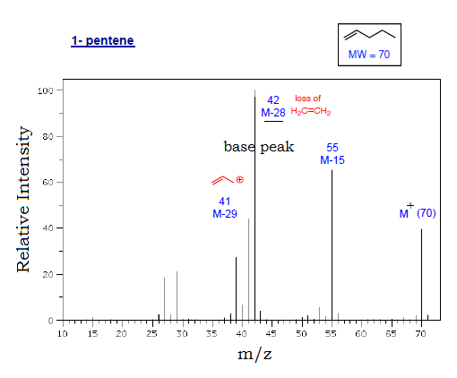

Slide 15
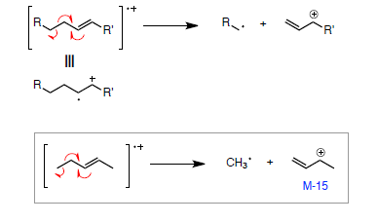
fragmentation processes • McLafferty rearrangement • allylic α-cleavage

Slide 16
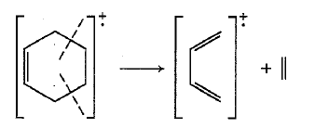
Cyclic Alkenes • Double bonds favor allylic cleavage to give the resonance stabilized allylic carbocation • Cyclohexenes can undergo retro-Diels-Alder reactions; may be significant • Side chains are easily fragmented

Slide 17
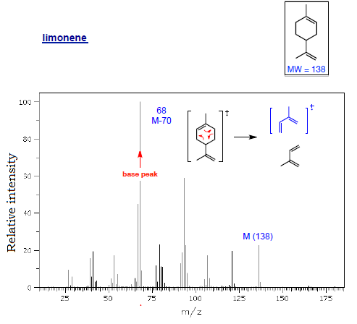

Slide 18
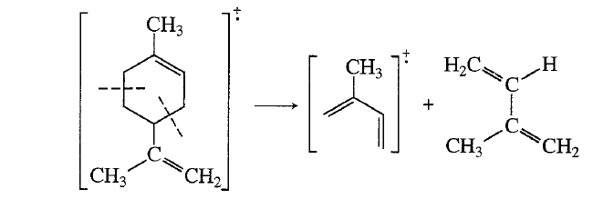

Slide 19
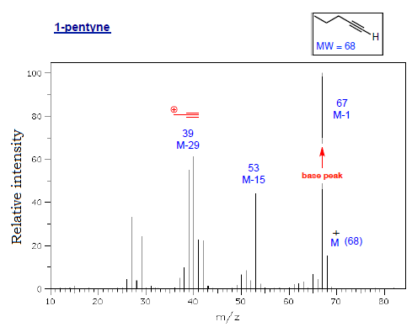
Alkynes • Strong M-1 peak is observed in ter. alkynes • Strong peak from fragmentation to give resonance stabilized propargyl cation(m/z = 39 [important]in terminal alkynes)

Slide 20
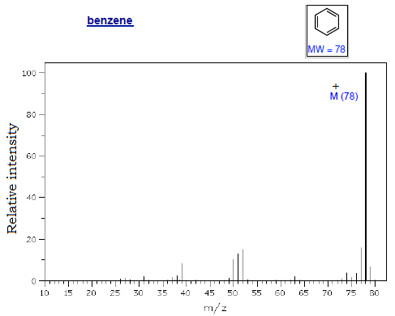
Aromatic Hydrocarbons • Strong M⁺ ion • Strong M-1

Slide 21
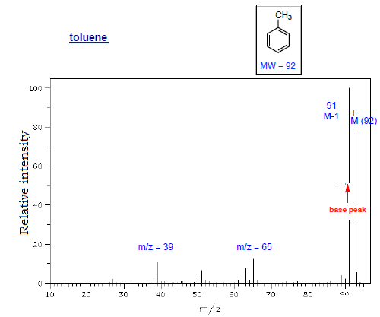
* Methyl benzene= give benzyl cation= tropylium ion • Substituted benzenes can undergo McLafferty r.r. (substitutent = propyl or larger)

Slide 22
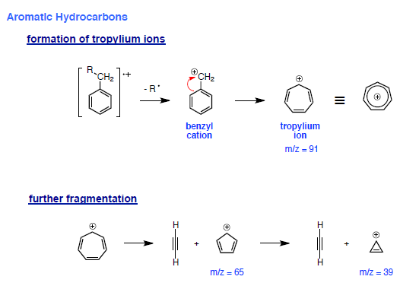

Slide 23
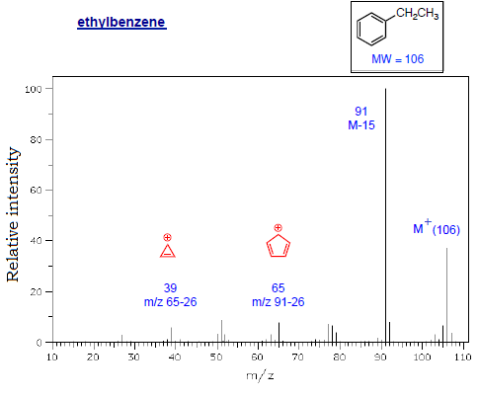

Slide 24
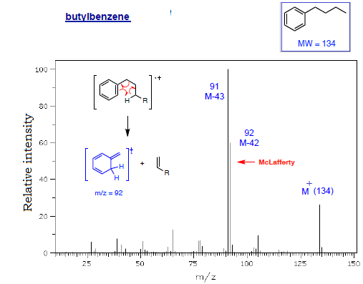

Slide 26
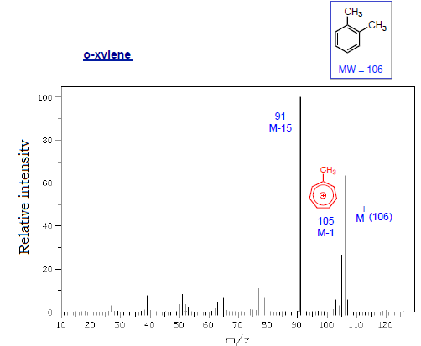

Slide 27
Cpds with Heteroatoms molecules containing O,N, halogens or other heteroatoms often undergo α-cleavage ( adjacent to heteroatom) - Driving force is resonance stabilized cations minor

Slide 28
Alcohols Acyclic Alcohols • Weak M⁺ peak; may be absent • Dehydration (M-18), sometimes with loss of CH2=CH2 • α-Cleavage of an alkyl radical (1° alcohols show m/z = 31) Largest substituent lost first • Loss of H radical adjacent to OH (M-1) may occur; usually

Slide 29
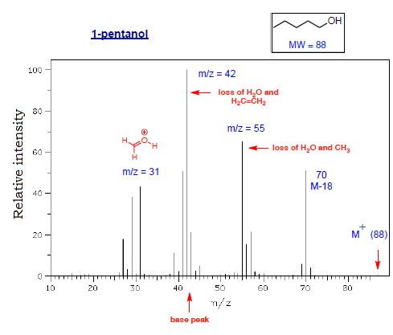

Slide 30
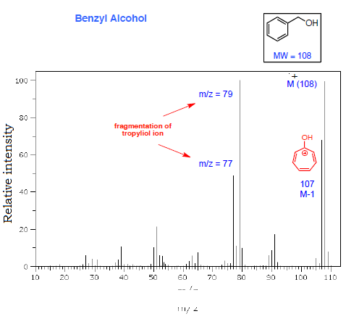
Benzyl Alcohols • Strong M⁺ peak • formation of tropyliol ions; then fragmentation to C6H5

Slide 31
fragmentation of tropyliol dehydration

Slide 32
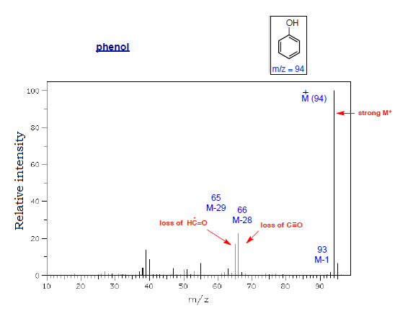
Phenols • Strong M⁺ peak • May show strong [M-1] • Loss of C≡O (M-28) and net loss of formyl radical (M-29)

Slide 33
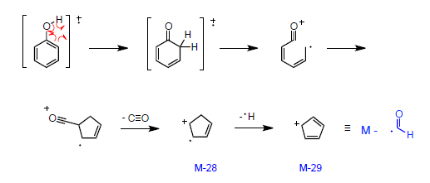
Loss of C≡O and H-C=O radical

Slide 34
Ether

